Slide 1
Web Technology
Module II: HTML5 and Web Page Structuring

Slide 2
HTML basics – elements, tags, attributes, document structure.Text formatting and hyperlinks.
Lists, tables, anchors, forms and input elements. HTML5 semantic tags – header, footer, nav, article, section.
Embedding media – audio, video, iframes. Canvas and SVG basics.
Responsive design with HTML meta viewport. Accessibility standards – ARIA roles, alt text, best practices.

Slide 3
HTML
HTML
Hyper
Text
Markup
Language

Slide 4
HTML Intro
•HTML stands for Hyper Text Markup Language
•HTML is the standard markup language for creating Web pages
•HTML describes the structure of a Web page
•HTML consists of a series of elements
•HTML elements tell the browser how to display the content

Slide 5
HTML Versions
Version | Year
HTML | 1991
HTML 2.0 | 1995
HTML 3.2 | 1997
HTML 4.01 | 1999
XHTML | 2000
HTML5 | 2014

Slide 6
HTML Tags
HTML tags are element names surrounded by angle brackets:
<tagname>content goes here...</tagname>
HTML tags normally come in pairs like <p> and </p>
The first tag in a pair is the start tag, the second tag is the end tag
The end tag is written like the start tag, but with a forward slash inserted before the tag name

Slide 7
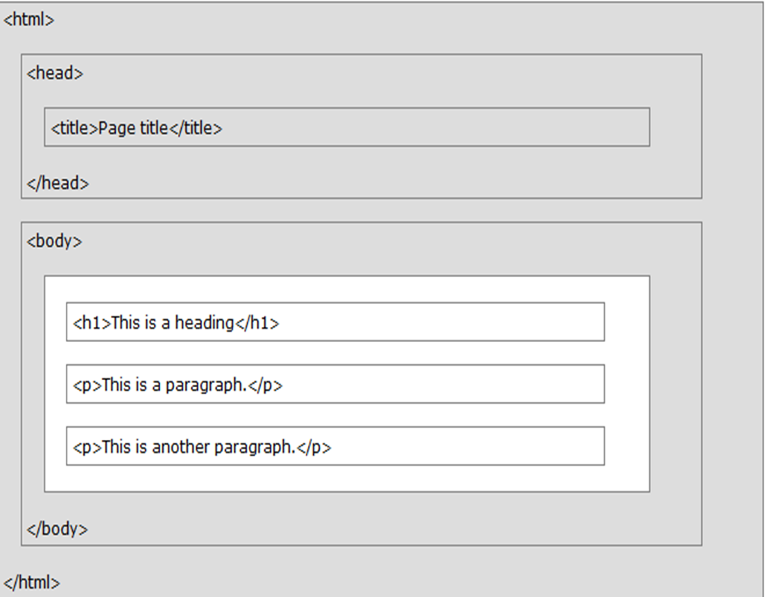
HTML Page Structure

Slide 8
HTML Elements
Headings,
paragraphs,
line break,
Text Formatting (Value Addition)
colors and fonts,
links,
Hyperlink-anchor tag ( Value Addition)
images
lists,
tables,
frames and forms,
Span and Div tag ( Value Addition)

Slide 9
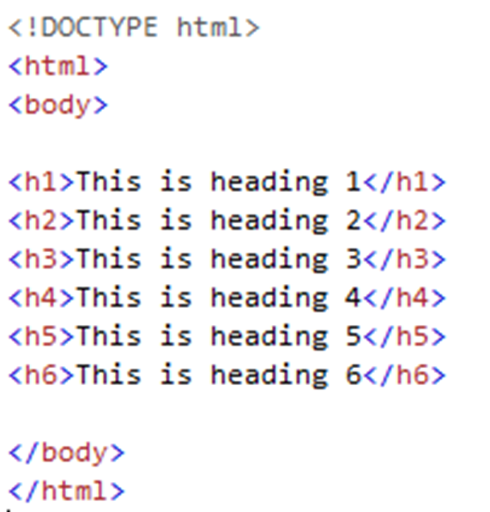
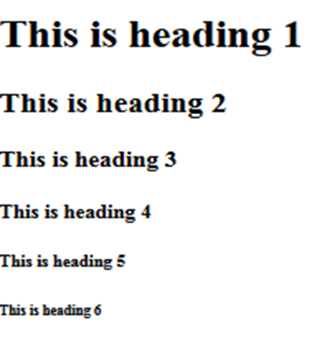
HTML- Heading Tags
HTML headings are defined with the <h1> to <h6> tags. <h1> defines the most important heading. <h6> defines the least important heading:
Output

Slide 10
HTML- Paragraph Tag, Line Break and Horizontal Line
<p> </p> is used for paragraph tags.
<p>This is my first paragraph</p>
<br> is used for Line break- is Singular Tag
&nbsp for space
<hr> is used to add Horizontal line.
Its is Singular Tag

Slide 11
Text Formatting Tags
<b></b> | bold
<i></i> | italicized
<u></u> | underlined
<sup></sup> | Sample^{superscript}
<sub></sub> | Sample_{subscript}
<strong></strong> | strong
<em></em> | emphasized
<pre></pre> | Preformatted text
<blockquote></blockquote> | Quoted text block
<del></del> | Deleted text – strike through

Slide 12
Fonts & Colors
<Font> Text Comes Here </Font>
What attributes can use with Font tag:
face
size
color

Slide 13
Fonts & Colors
You can set font face using face attribute
Example:- <font face = "Times New Roman" > Hello </font>
face
size
color

Slide 14
Fonts & Colors
You can set content font size using size attribute.
The range of accepted values is from 1(smallest) to 7(largest).
The default size of a font is 3
Example:- <font size = "5"> Hello </font>
face
size
color

Slide 15
Fonts & Colors
You can set font color using color attribute.
You can specify the color either by color name or hexadecimal code for that color.
<font color = "#FF00FF"> Hello </font>
<font color = "red"> Hello </font>
face
size
color

Slide 16
Fonts & Colors
You can set font face using face attribute
Example:- <font face = "Times New Roman" > Hello </font>
You can set content font size using size attribute.
The range of accepted values is from 1(smallest) to 7(largest).
The default size of a font is 3
Example:- <font size = "5"> Hello </font>
face
size
color
You can set font color using color attribute.
You can specify the color either by color name or hexadecimal code for that color.
<font color = "#FF00FF"> Hello </font>
<font color = "red"> Hello </font>

Slide 17
HyperLinks- Value Addition
The <a> tag defines a hyperlink, which is used to link from one page to another
The href attribute of <a> element indicates the link's destination
The target attribute specifies where to open the linked document.
Example- target = _blank - Opens the linked document in a new window or tab

Slide 18
HyperLinks
Link to a document called a1.html in the same directory
<a href="a1.html"> Click </a>
Link to a document called parent.html in the parent directory
<a href="../parent.html"> Click </a>
Link to a document called a1.html in the subdirectory WTL
<a href="WTL/a1.html"> Click </a>
Link to an external Web site snjb.org
<a href="http://www.snjb.org">Click Here</a>

Slide 19
HyperLinks
Link to the same Document
Example:-
<a href="#section1">Introduction</a><br>
<a href="#section2">background</a><br>
<h2 id="section1">Introduction</h2>
... Section 1 follows here …
<h2 id="section2">background</h2>
... Section 2 follows here ...

Slide 20
Link tag
<head>
<link rel="stylesheet" href="styles.css">
</head>
Link tag is used to Link to an external style sheet
The <link> tag defines the relationship between the current document and an external resource.
rel- Required attribute. It specifies the relationship between the current document and the linked document

Slide 21
Images- img tag
<img src= “index.jpeg” >
src | Location of image file
alt | Substitute text for display (e.g. in text mode)
height | Number of pixels of the height
width | Number of pixels of the width
border | Size of border, 0 for no border
img tag attributes
<img src= “index.jpeg” alt= “Home page” height= "500" width="600" border= “2” >

Slide 22
List tag
List Types
Ordered
Unordered
Definition
<ol>
<ul>
<dl>

Slide 23
List tag- Ordered List
<ol>
<li>Apple</li>
<li>Orange</li>
<li>Grapefruit</li>
</ol>
<ol type="A" >
<li>Apple</li>
<li>Orange</li>
<li>Grapefruit</li>
</ol>
<ol type="a" >
<li>Apple</li>
<li>Orange</li>
<li>Grapefruit</li>
</ol>
1. Apple
2. Orange
3.Grapefruit
Apple
Orang
Grapefruit
<ol type="1" >
<li>Apple</li>
<li>Orange</li>
<li>Grapefruit</li>
</ol>
<ol type="I" >
<li>Apple</li>
<li>Orange</li>
<li>Grapefruit</li>
</ol>
<ol type="i" >
<li>Apple</li>
<li>Orange</li>
<li>Grapefruit</li>
</ol>
1. Apple
2. Orange
3.Grapefruit
Apple
Orang
Grapefruit

Slide 24
List tag- Unordered List
<ul >
<li>Apple</li>
<li>Orange</li>
<li>Grapefruit</li>
</ul>
<ul type="disk" >
<li>Apple</li>
<li>Orange</li>
<li>Grapefruit</li>
</ul>
Apple
Orange
Grapefruit
Apple
Orange
Grapefruit
<ul type="Square" >
<li>Apple</li>
<li>Orange</li>
<li>Grapefruit</li>
</ul>
<ul type="Circle" >
<li>Apple</li>
<li>Orange</li>
<li>Grapefruit</li>
</ul>
Apple
Orange
Grapefruit
  Apple
  Orang
  Grapefruit

Slide 25
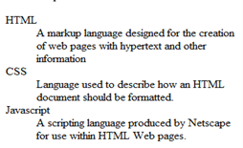
List tag- Definition List
Create definition lists using <dl>
definition in <dd> tag
text is in <dt> tag,
<dl>
<dt>HTML</dt>
<dd>A markup language …</dd>
<dt>CSS</dt>
<dd>Language used to …</dd>
</dl>

Slide 26
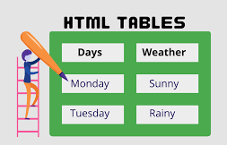
HTML Table

Slide 27
HTML Table
Tag | Description
<table> | Defines a table
<th> | Defines a header cell in a table
<tr> | Defines a row in a table
<td> | Defines a cell in a table
<caption> | Defines a table caption
<colgroup> | Specifies a group of one or more columns in a table for formatting
<col> | Specifies column properties for each column within a <colgroup> element
<thead> | Groups the header content in a table
<tbody> | Groups the body content in a table
<tfoot> | Groups the footer content in a table

Slide 28
HTML Table
<tr>
<th> | <th> | <th>
<tr>
<tr>
<tr>
<td>
<td>
<td>

Slide 29
HTML Table Example-1
Student Database Table
Roll-No | Name | Address
1 | Bhavana | Nashik
2 | Amit | Pune
3 | Neha | Mumbai

Slide 30
HTML Table Example-1
<html>
<body>
<table border=1 width=50% cellspacing=0>
<tr>
<th>RollNo</th>
<th>Name</th>
<th>Address</th>
</tr>
<tr>
<td>1</td>
<td>Bhavana</td>
<td>Nashik</td>
</tr>
<tr>
<td>2</td>
<td>Amit</td>
<td>Pune</td>
</tr>
<tr>
<td>3</td>
<td>Neha</td>
<td>Mumbai</td>
</tr>
</table>
</body>
</html>

Slide 31
HTML Table Example-2
Roll-No | Name | Address
1 | Bhavana | Nashik
2 | Amit | Pune
3 | Neha | Mumbai

Slide 32
HTML Table Example-2
<html>
<body>
<table border=1 width=50% cellspacing=0>
<tr bgcolor=red>
<th>RollNo</th>
<th>Name</th>
<th>Address</th>
</tr>

Slide 33
HTML Table Example-3
Roll-No | Name | Address
1 | Bhavana | Nashik
2 | Amit | Pune
3 | Neha | Mumbai
4 | Sameer | Chandwad
5 | Varun | Bhopal

Slide 34
HTML Table Example-3
<html>
<head>
<style>
tr:nth-child(even)
{ background-color:skyblue; }
</style>
</head>
<body>

Slide 35
HTML Table Example-4
Roll-No | Name | Address
1 | Bhavana | Nashik
2 | Amit | Pune
3 | Neha | Mumbai
4 | Sameer | Chandwad
5 | Varun | Bhopal

Slide 36
HTML Table Example-4
<html>
<body>
<table border=1 width=50% cellspacing=0>
<colgroup>
<col style="background-color:skyblue">
</colgroup>
<tr>
<th>RollNo</th>
<th>Name</th>
<th>Address</th>
</tr>
<tr>

Slide 37
HTML Table Example- 5
Month | Savings
January | $100
February | $80
Sum | $180
<thead>
<tbody>
<tfoot>

Slide 38
HTML Table Example- 5
<tr>
<td>Feb</td>
<td>$80</td>
</tr>
</tbody>
<tfoot style=color:red>
<tr>
<td>Total</td>
<td>$180</td>
</tr>
</tfoot>
</table>
</body>
</html>
<html>
<body>
<table border=1 bordercolor=black>
<thead style=color:green>
<tr>
<th>Month</th>
<th>savings</th>
</tr>
</thead>
<tbody style=color:blue>
<tr>
<td>Jan</td>
<td>$100</td>
</tr>

Slide 39
HTML Table Example-6
Time/Day | Monday | Tuesday | Wednesday | Thursday
10:00-11:00 | DBMS | Maths | DBMS | DBMS
11:00-12:00 | WT | DBMS | WT | Maths
12:00-12:30 | Lunch Break
12:30-1:30 | Maths | DBMSL(PR) T1 Batch | Maths | DBMSL(PR) T2 Batch
1:30-2:30 | ADS |  | ADS

Slide 40
<html>
<body>
<table border=1 width=50% align=center>
<tr>
<th>Time/Day </th>
<th> Mon </th>
<th> Tue </th>
<th> Wed </th>
<th> Thus </th>
</tr>
<tr>
<td>10:00-11:00 </td>
<td>DBMS </td>
<td>Maths </td>
<td>DBMS </td>
<td>DBMS</td>
</tr>
<tr>
<td>11:00-12:00 </td>
<td>WT </td>
<td>DBMS </td>
<td>WT </td>
<td>Maths</td>
</tr>
<tr>
<td>12:00-12:30 </td>
<td colspan=4 align=center bgcolor=yellow>Lunch Break</td>
</tr>
<tr>
<td>12:30-1:30 </td>
<td>Maths </td>
<td rowspan=2>DBMSL(PR) Batch T1 </td>
<td>Maths </td>
<td rowspan=2>DBMSL(PR) Batch T2</td>
</tr>
<tr>
<td>1:30-2:30 </td>
<td>ADS </td>
<td>ADS </td>
</tr>
</table>
</body>
</html>

Slide 41
Span and Div tag- Value Addition
•The <span> tag is an inline container used to mark up a part of a text, or a part of a document.
•The <span> tag is much like the <div> element, but <div> is a block-level element and <span> is an inline element.

Slide 42
Span and Div tag- Value Addition
<html>
<body>
My mother has <span style="color:blue"> blue </span> eyes and my father has <span style="color:green">dark green</span> eyes.
</body>
</html>
<html>
<body>
My mother has <div style="color:blue"> blue </div> eyes and my father has <div style= "color:green"> dark green</div> eyes.
</body>
</html>

Slide 43
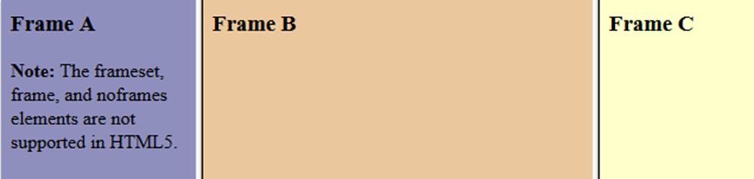
HTML Frames
•Example
A simple three-framed page:
<frameset cols="25%,50%,25%">
<frame src="frame_a.htm">
<frame src="frame_b.htm">
<frame src="frame_c.htm">
</frameset>
Each <frame> in a <frameset> can have different attributes, such as border, scrolling, the ability to resize, etc.

Slide 44
Web Technology
Topic:
HTML Forms

Slide 45
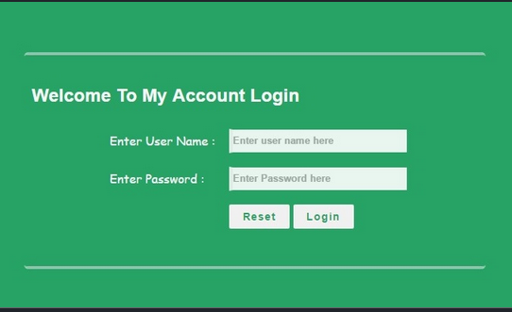
HTML Form Example-1-
Login Page

Slide 46
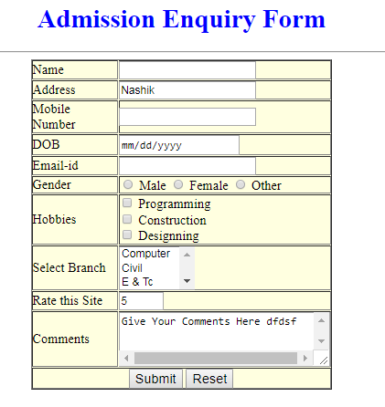
HTML Forms – Example 2 Registration Form

Slide 47
HTML Form Elements
Tag | Description
<form> | Defines an HTML form for user input
<input> | Defines an input control
<textarea> | Defines a multiline input control (text area)
<label> | Defines a label for an <input> element
<select> | Defines a drop-down list
<option> | Defines an option in a drop-down list
<button> | Defines a clickable button

Slide 48
HTML Input Types
<input type="text">
<input type="number">
<input type="password">
<input type="date">
<input type="email">
<input type="color">
<input type="checkbox">
<input type="radio">
<input type="file">
<input type="reset">
<input type="submit">
<input type="button">

Slide 49
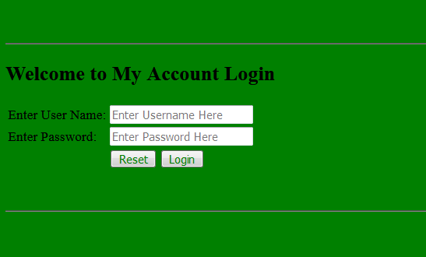
HTML Form Example-1- Login Page

Slide 50
<html>
<body bgcolor=green>
<br><br><hr>
<h2> Welcome to My Account Login </h2>
<table>
<tr>
<td>Enter User Name:</td>
<td>
<input type=text placeholder="Enter Username Here">
</td></tr>
<tr>
<td>Enter Password:</td>
<td>
<input type=password placeholder="Enter Password Here">
</td></tr>
<tr>
<td></td>
<td>
<input type=reset value=Reset style=color:green>
<input Type =submit value=Login style=color:green>
</td>
</tr>
</table>
<br><br><hr>
</body>
</html>

Slide 51
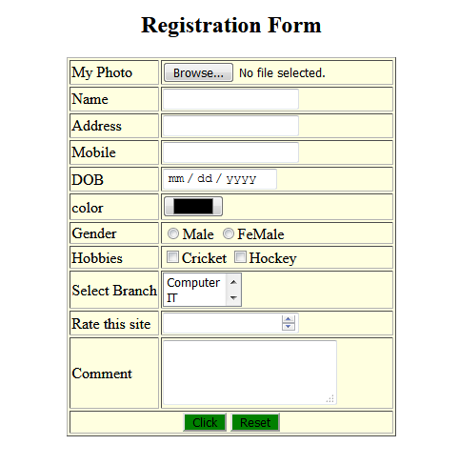
HTML Forms – Example 2 Registration Form

Slide 52
<html>
<body >
<h2 align=center> Registration Form </h2>
<table b>
<tr>
<td>My Photo</td>
<td><input type=file></td>
</tr>
<tr>
<td>Name</td>
<td><input type=text></td>
</tr>
<tr>
<td>Address</td>
<td><input type=text></td>
</tr>
<tr>
<td>Mobile </td>
<td><input type=text></td>
</tr>
<tr>
<td>DOB </td>
<td><input type=date></td>
</tr>
<tr> <td>color </td>
<td><input type=color></td> </tr>
<tr>
<td>Gender </td>
<td>
<input type=radio>Male
<input type=radio>FeMale
</td>
</tr>
<tr>
<td>Hobbies </td>
<td>
<input type=checkbox>Cricket
<input type=checkbox>Hockey
</td>
</tr>

Slide 53
<tr>
<td>Select Branch </td>
<td>
<select size=2>
<option> Computer</option>
<option> IT</option>
<option> Civil</option>
</select>
</td>
</tr>
<tr>
<td>Rate this site </td>
<td>
<input type=number min=1 max=5>
</td>
</tr>
<tr>
<td>Comment </td>
<td>
<textarea col=10 rows=3>
</textarea>
</td>
</tr>
<tr>
<td colspan=2 align=center>
<button >Click</button>
<button >Reset</button>
</td>
</tr>
</body>
</html>

Slide 54
Web Technology
Topic:
Difference Between HTML & HTML5

Slide 55
Html | Html5
DOCTYPE declaration in Html is too longer | DOCTYPE declaration in Html5 is very simple "<!DOCTYPE html>
character encoding in Html is also longer <!DOCTYPE HTML PUBLIC "-//W3C//DTD HTML 4.0 Transitional//EN"> | character encoding (charset) declaration is also very simple <meta charset="UTF-8">
Audio and Video are not part of HTML4 | Audio and Videos are integral part of HTML5 e.g. <audio> and <video> tags.
Vector Graphics is possible with the help of technologies such as VML, Silverlight, Flash etc | Vector graphics is integral part of HTML5 e.g. SVG and canvas
It is almost impossible to get true GeoLocation of user browsing any website especially if it comes to mobile devices. | JS GeoLocation API in HTML5 helps identify location of user browsing any website (provided user allows it)
.It provides local storage in place of cookies. | Html5 use cookies
Not possible to draw shapes like circle, rectangle, triangle. | Using Html5 you can draw shapes like circle, rectangle, triangle.
Does not allow JavaScript to run in browser. JS runs in same thread as browser interface. | Allows JavaScript to run in background. This is possible due to JS Web worker API in HTML5
Works with all old browsers | Supported by all new browser.

Slide 56
HTML 5 Tags
<mark>
<audio>
<video>
<Progress>
<nav>
Canvas

Slide 57
Web Technology
Topic:
CSS- Cascading Style sheet

Slide 58
CSS
CSS
Cascading
Style
Sheets

Slide 59
CSS-Syntax
SPV
Selector
Property
Value
Selector{ Property : Value;}
P { color : red ;}

Slide 60
CSS-Syntax
Selector
HTML tag
Id
Class
p { color : red ;}
#a { color : red ;}
.a { color : red ;}
<p> Hello </p>
<p id=a> Hello</p>
<p class=a> Hello</p>

Slide 61
Types of CSS
Types of CSS
Inline
Internal
External

Slide 62
Types of CSS
Write CSS code inside HTML Tag
CSS code as attribute of HTML tag
Code starts with Style
Example: <p style= “color:red” >
Inline CSS

Slide 63
Types of CSS
Write CSS code inside HTML Head Tag
Use <style> tag inside Head tag
Example: <head> <style> p { color: red;} </style> </head>
Internal CSS

Slide 64
Types of CSS
2 Files 1> .html 2> .css
write css code in .css file
Give link of .css file inside .html file, under head tag, in <link> tag
External CSS

Slide 65
External CSS Example
a1.html
a2.css
<html>
<head>
<link rel="stylesheet" type="text/css" href="a2.css">
</head>
<body>
<p> Hello Good Morning </p>
</body> </html>
p { color: red;}

Slide 66
When to use which Types of CSS
Types of CSS
Inline
Internal
External
When your website is having multiple html files and you want same style to be applied for every html page
When you want to use css property for only one tag in html
When you want to use css property for more than one tag and you have only one html file.

Slide 67
CSS Properties
CSS Color
CSS background
CSS Border
CSS Text
CSS Font
CSS Margin
CSS Padding
CSS Table

Slide 68
CSS Properties- Color
color: value
Example:
color : blue;

Slide 69
CSS Properties-background
background-color
  Example:
    h1 { background-color: green; }
background-image
  Example:
    body { background-image: url("paper.gif"); }

Slide 70
CSS Properties- border
border-style (dotted,dashed,solid,double etc)
  Example: P {border-style: dotted;}
border-width (value in px)
  Example: P {border-width: 5px;}
border-color (red, blue, green etc)
  Example: P {border-color: red;}
border-radius (value in px)
  Example: P{border-radius: 12px;}

Slide 71
CSS Properties -Text
color
background-color
text-alignment (left, right, center, justify)
text-decoration (overline, underline, linethrough)
text-transform (uppercase, lowercase, capitalize)

Slide 72
CSS Properties- Font
Font-family
Font-Style( normal, italic)
font-size( in px)
font-weight(normal,bold)

Slide 73
CSS Properties- Margin
margin-top
margin-right
margin-bottom
margin-left

Slide 74
CSS Properties- Padding
padding-top
padding-right
padding-bottom
padding-left

Slide 75
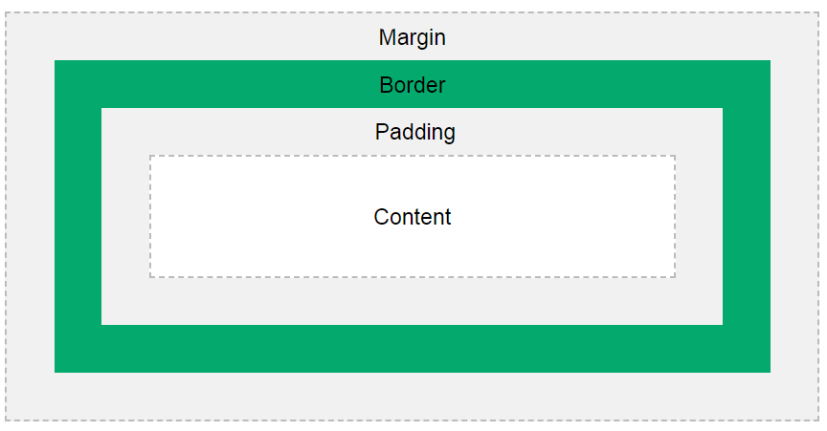
CSS Box Model

Slide 76
CSS Properties- Table
tr:hover {background-color: grey;}
tr:nth-child(even) {background-color: green;}
Size
Border

